Slide 1
Создание собственной библиотеки для акустической аналогии в OpenFOAM
Сергей Стрижак
2013

Slide 2
Структура директории «src» в OpenFOAM
$ tree -L 1 -d $WM_PROJECT_DIR/src
Либо $ FOAM_SRC
finiteVolume This library provides all the classes needed for the finiteVolume discretization, such as fvMesh, divergence, laplacian, gradient discretization operators, matrix solvers, and boundary conditions.
OpenFOAM This library includes the definitions of the containers used for the operations, the field definitions, the declaration of the mesh and of all the mesh features such as zonesand sets
turbulenceModels which contains several turbulence models
engine declaration of classes for engine simulation
dynamicMesh for moving meshes algorithms

Slide 3
Библиотеки согласно H. Jasak
Physical modelling libraries group models that perform the same function under a
same virtual base class (interface)
Libraries grouped by functionality; some are specific for the purpose. Example:
Transport models: single- and multi-phase viscosity models
Turbulence models: incompressible RANS turbulence
Each model is implemented independently and carries its own parameters
Some application carry their own models, run-time selection and libraries
Libraries
Thermophysical models: real properties of liquids, gasses and mixtures.
Chemistry models combustion thermo-chemistry, interface to JANAF and CHEMKIN packages
Transport models: fluid viscosity
Incompressible and compressible RANS turbulence models
LES models: filter size and filter functions, incompressible and compressible LES
models, LES wall functions
Diesel spray models: atomisation, breakup, collision, dispersion, drag, evaporation
heat transfer, wall interaction

Slide 4
Библиотеки согласно H. Jasak
Utility Libraries
Common functionality used in several solvers is implemented in generic form. In order to use it in multiple executables, it compiles into a library
Header files describe the classes: included in the top-level code or another library
Compiled code obtained by linking the library file
Beware: utilities are often written as templates: complete functionality in header files
Libraries
ODE: ordinary differential equation solvers
Dynamic mesh: topology modifiers, automatic mesh motion
Engine: internal combustion engine-specific classes
Error estimation: residual error estimates in operator form
Miscellaneous: meshTools, randomProcesses, postProcessing
Public domain tools, e.g. parallel communication

Slide 5
Class forces
OpenFOAM/src/postProcessing/functionObjects/
forces/forces/
forces.C
forces.dep
forcesFunctionobject.C
forcesFunctionobject.dep
forcesFunctionobject.H
forces.H
IOforces.H

Slide 6
Акустические аналогии
Стационарная
Керла (surface), Голдштейна (2D axi)
Proudman (volume)
Нестационарная
Лайтхилла
Ffowcs-Williams - Hawkings
Hall’s analogy

Slide 7
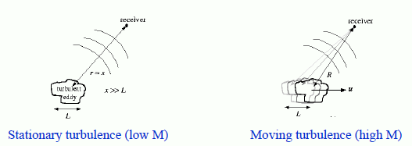




Slide 8
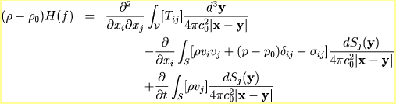


Аналогия Керла

Slide 9
Основные этапы для разработки новой библиотеки
Выбор акустической аналогии (аналогия Керла)
Определение исследуемых поверхностей
Загрузка исходных данных (количество узлов на поверхности исследуемой модели, координаты узлов, Tstart, Tend, нормали по поверхности, координаты поверхностей, значение давления)
Формирование служебных массивов
Определение физических переменных (C,r,dt, tetta, rho, V)
Расчет 3-х компонент сил Fx, Fy,Fz
Расчет положение слушателя
Расчет акустического давления
Расчет L (интенсивность шума)

Slide 10
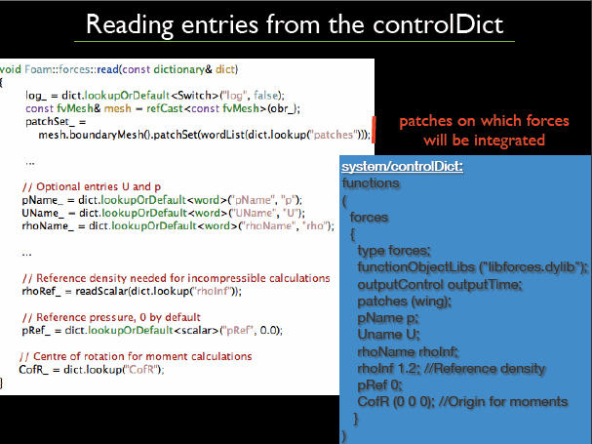

Slide 11
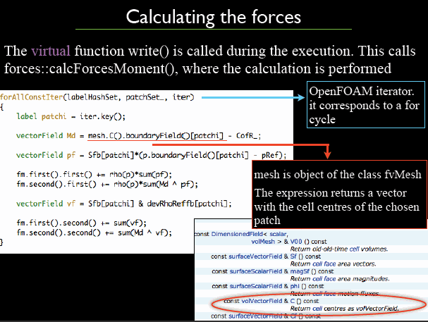

Slide 12
